Slide 1

Financial Inclusion & Digital Connectivity in Africa (2011–2023)
A comparative story of progress across South Africa, Kenya, and Ghana
By: Lorraine Lesia | Data Analyst | BI Analyst

Slide 2
Adults in Sub-Saharan Africa had access to financial services powered by mobile money
70%
43%
2011
2023

Slide 3



Digital connectivity
Our Research Focus
Unemployment
Financial inclusion

Slide 4
Years | Countries | Variables
2011 | South Africa | Account ownership
2015 | Kenya | Mobile money
2019 | Ghana | Internet users
2023 |  | GDP per Capita
 |  | Unemployment
 |  | Population

Slide 5
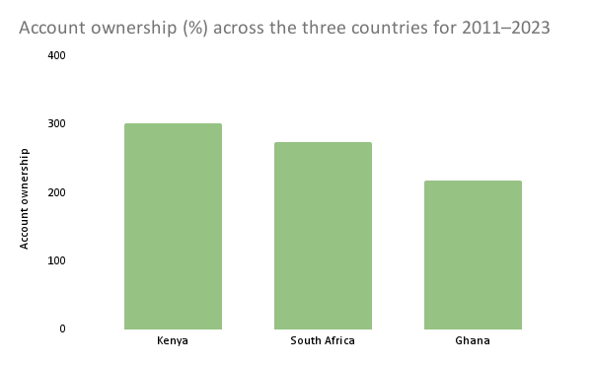
Account Ownership: The Foundation

Slide 6
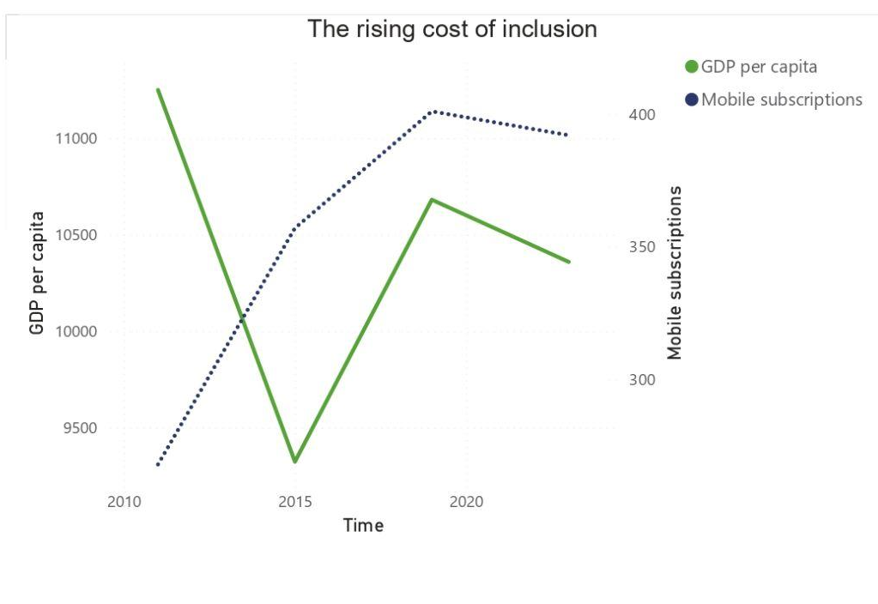

Slide 7
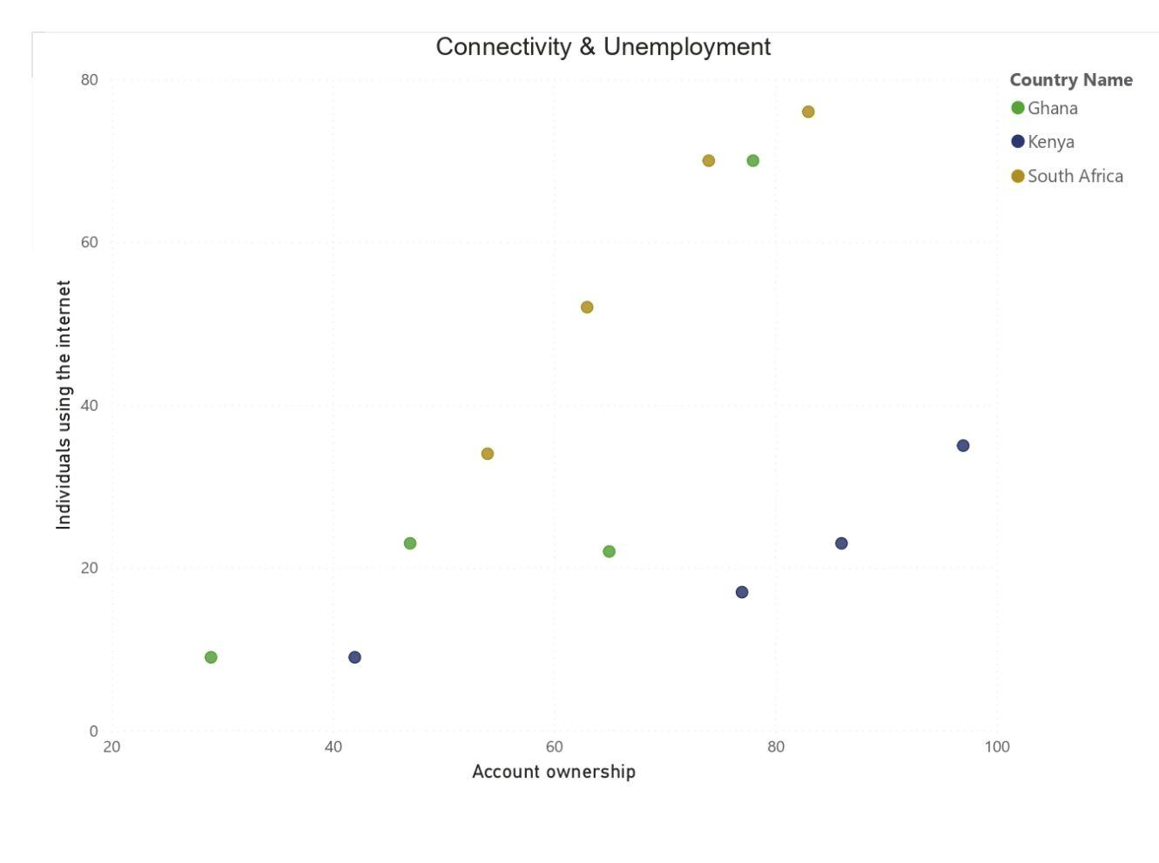

Slide 8
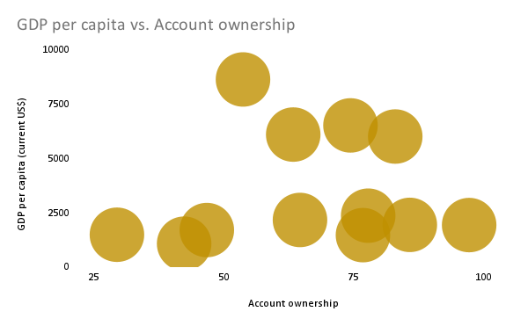
GDP vs Inclusion

Slide 9




Trends Over Time (2011–2023)
2011 — Banks dominate
2015 — Mobile money rises
2019 — Internet acceleration
2023 — Digital-first inclusion

Slide 10
Innovation drives inclusion
Connectivity > GDP
Formal systems must evolve

Slide 11
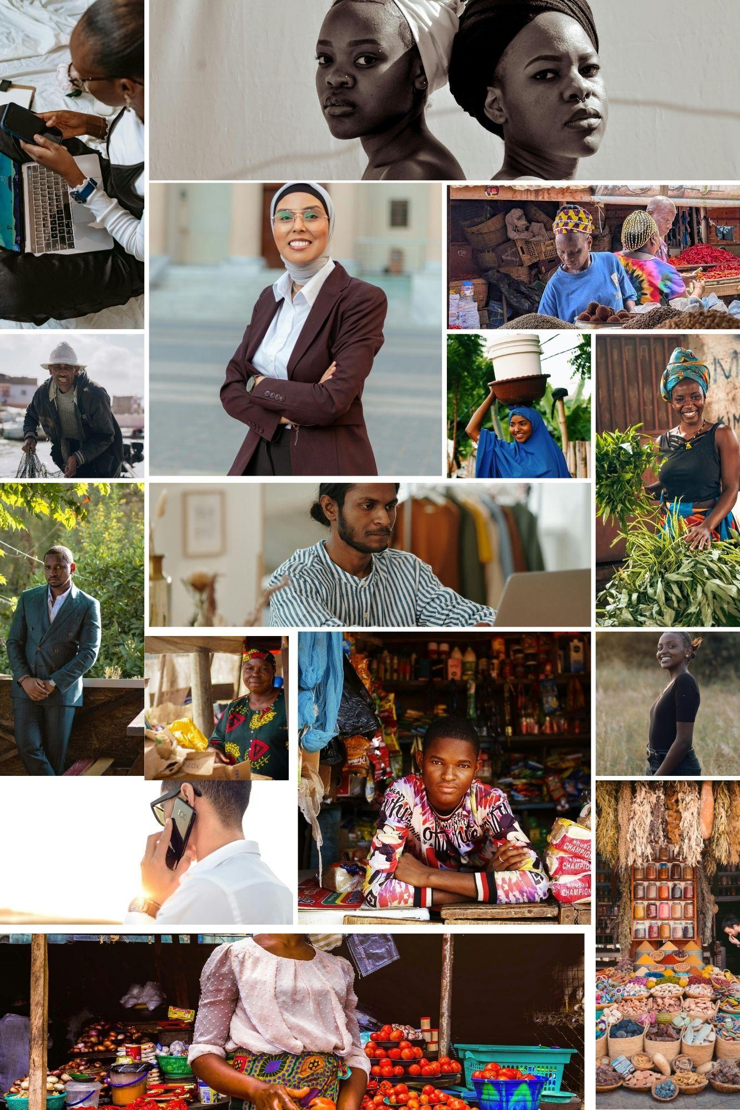

Slide 12
‘The future of inclusion isn’t built in banks it’s built in bandwidth.’
Lorraine Lesia

